Slide 1
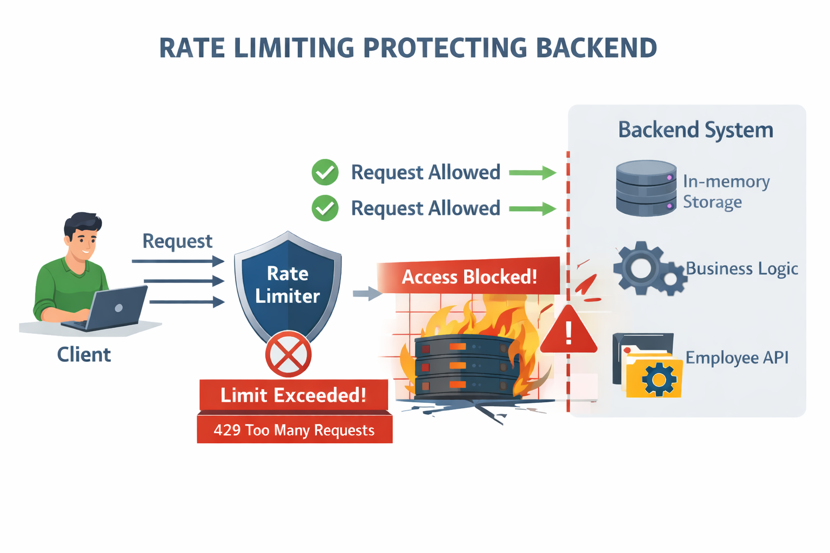
API Rate Limiter + Backend System
Token Bucket Based Rate Limiting using Spring Boot

Slide 2
What is Rate Limiting?
Each user can send limited requests
If limit is crossed → request is blocked
Example:
Limit = 5 requests
6th request → rejected

Slide 3
Token Bucket Concept
How it works:
Each user has a bucket
Bucket contains tokens
Each request uses 1 token
Tokens refill over time
Example:
Capacity = 5
Refill = 5 token/min
Request Result
1–5 Allowed
6 Rejected(429)

Slide 4
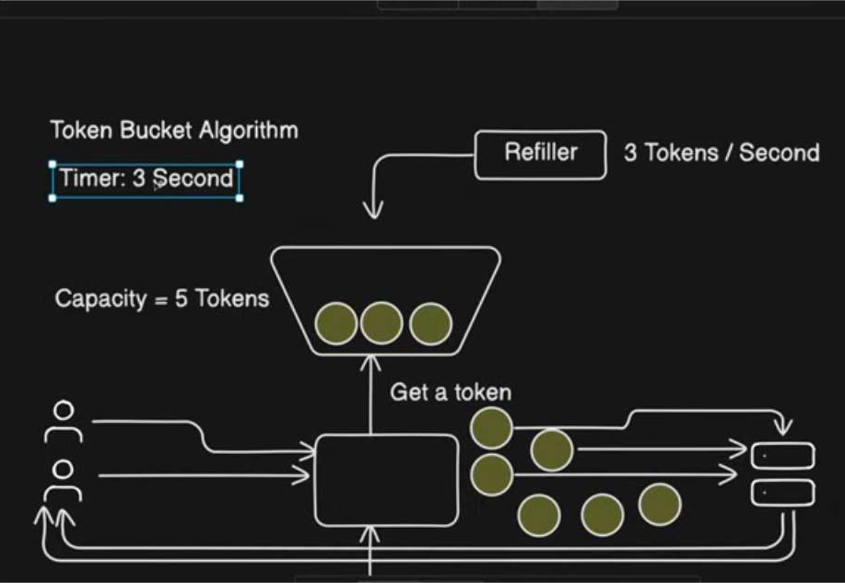

Slide 5
Overview:
Client
↓
Rate Limiter (Token bucket Check)
↓
Backend API (Employee CRUD)
↓
Response

Slide 6
if allowed
Client ----->Interceptor------>Controller------>Service------->Repository
(RateLimit)-------> Controller never Reaches
throws exception

Slide 7
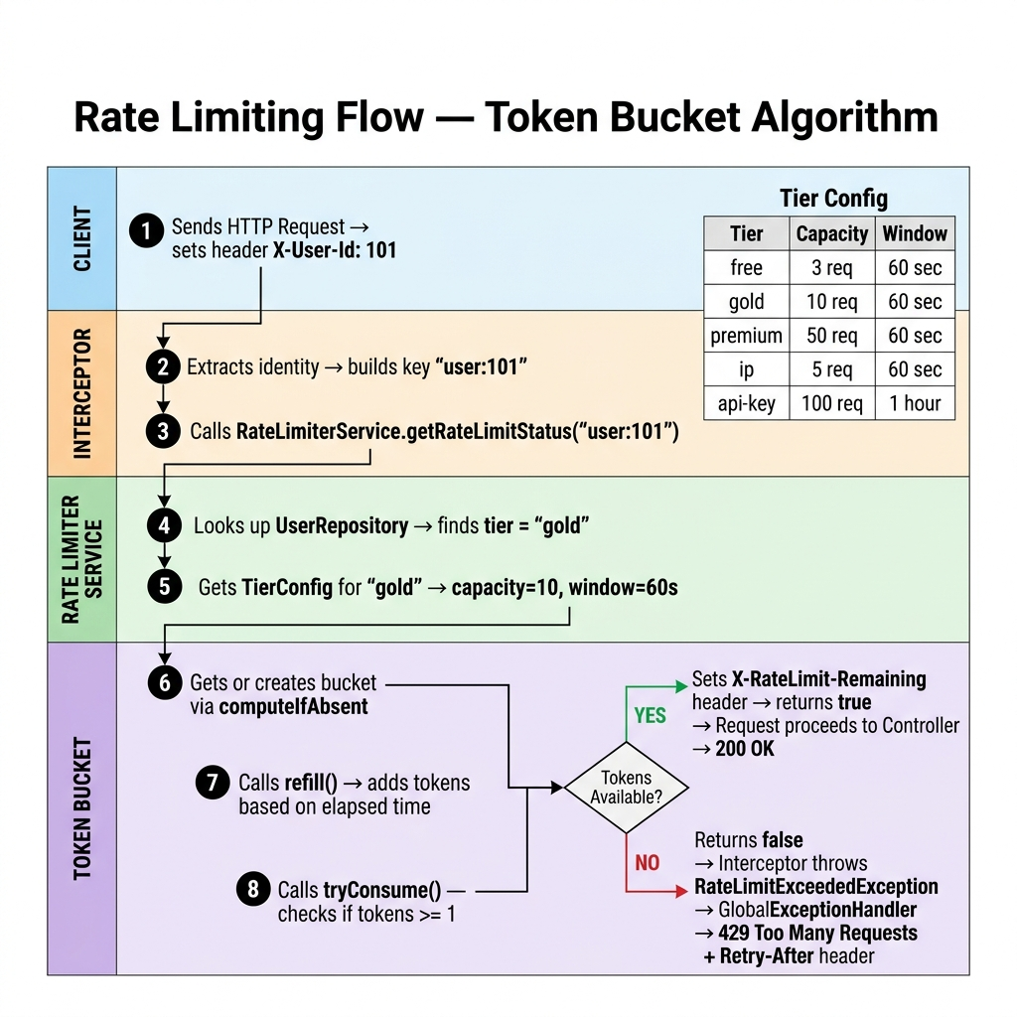

Slide 8
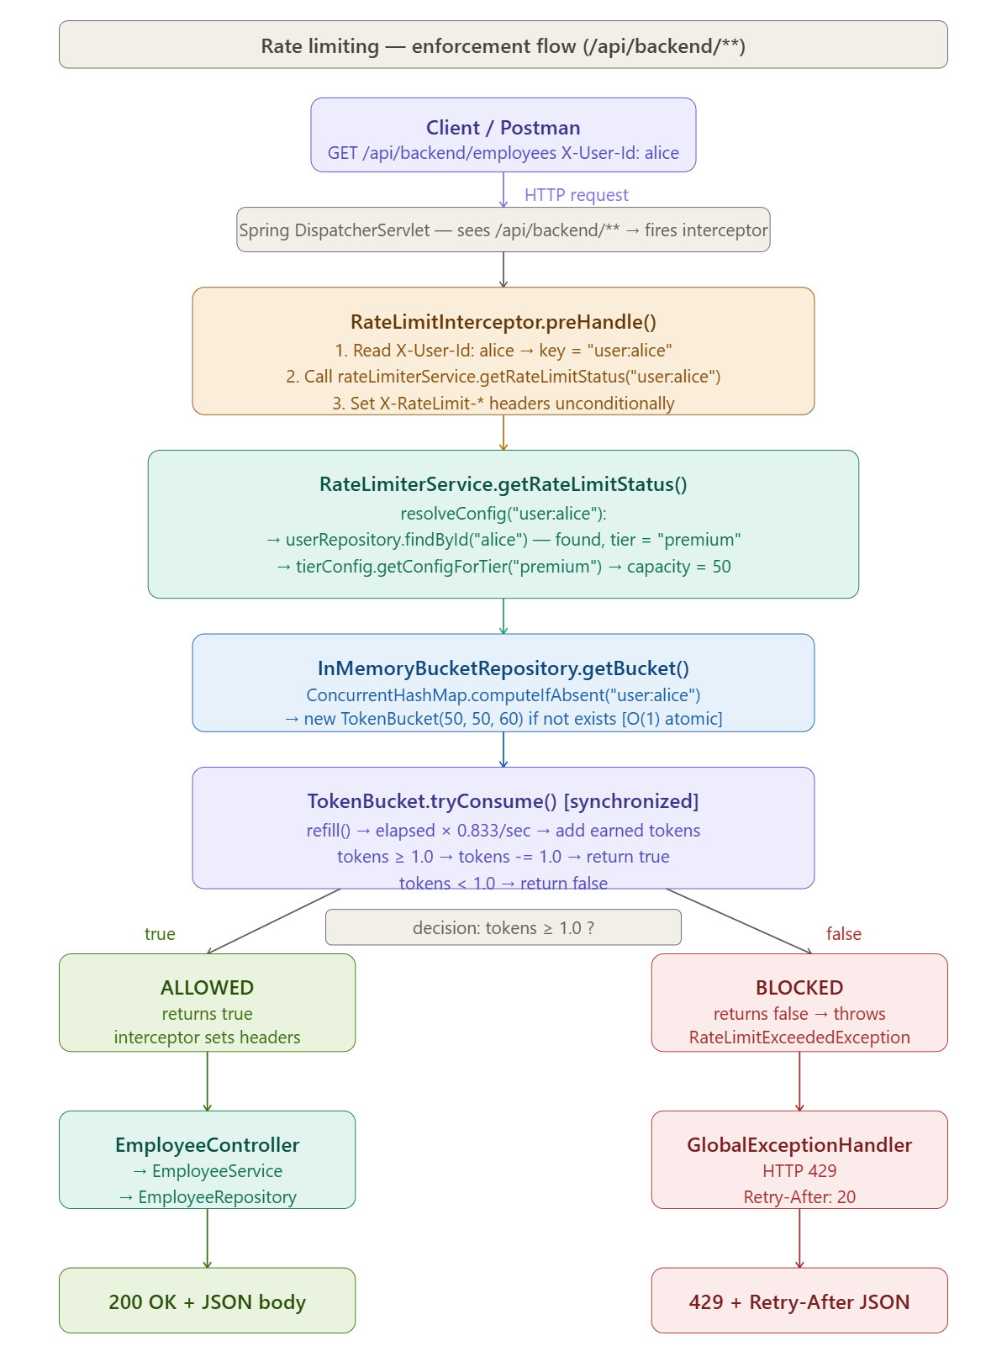

Slide 9
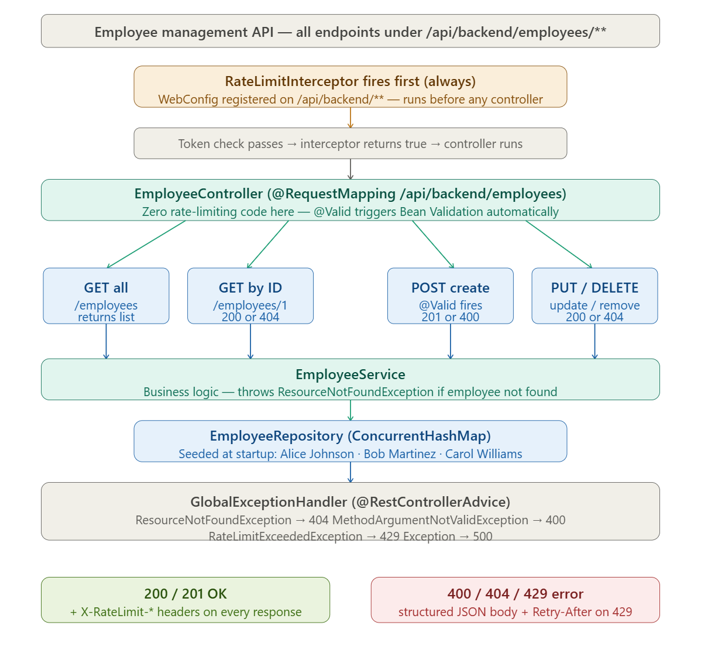

Slide 10
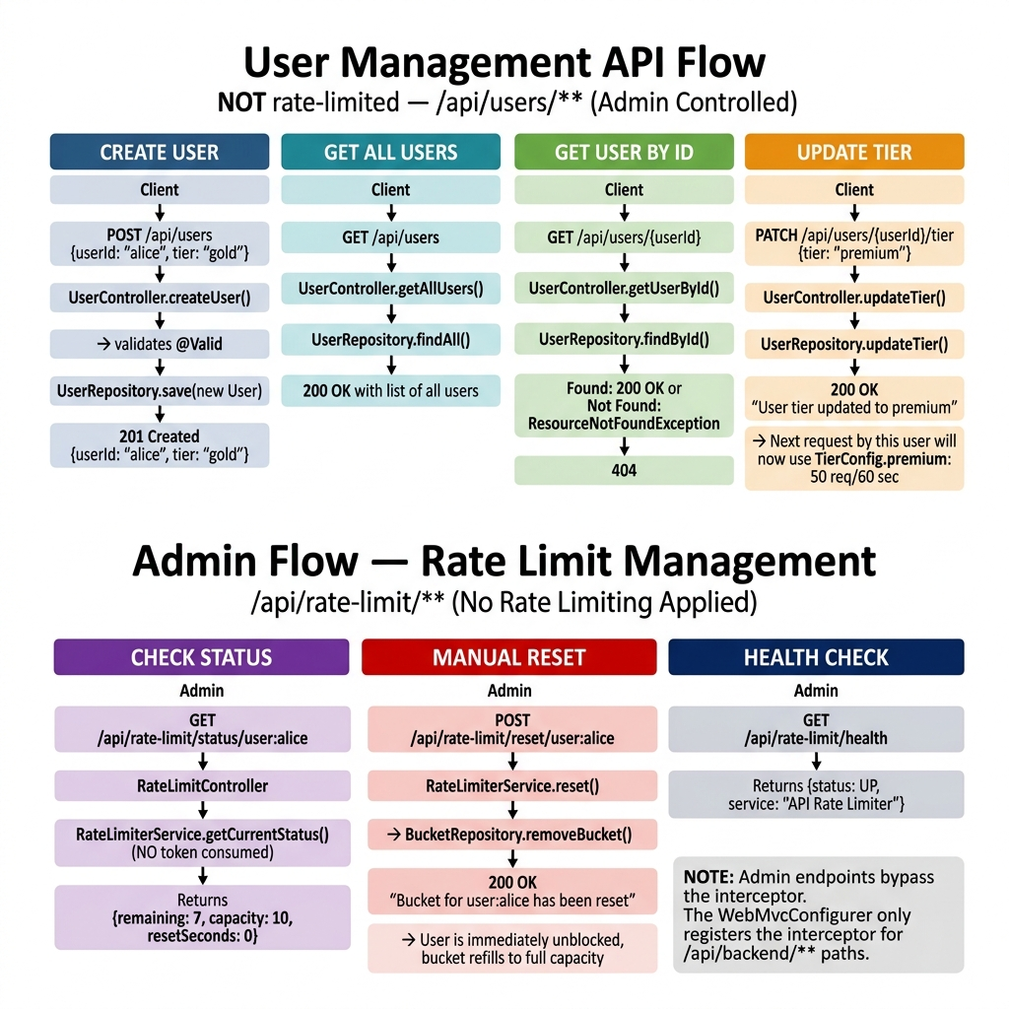


Slide 11
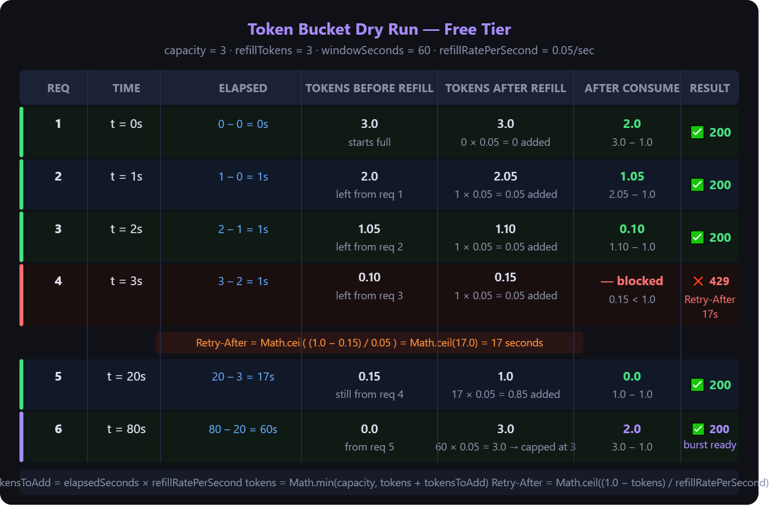

Slide 12
RateLimitServiceTest
shouldBlockAfterCapacityReached(): Ensures bucket respects capacity limit strictly
shouldReturnCorrectStatus() :Service correctly wraps bucket logic + exposes API-friendly response
shouldResetBucket() :Reset restores full capacity (important for admin/manual override cases)
shouldThrowWhenKeyIsNull(): I/p validation
shouldThrowWhenKeyIsBlank(): I/p validation

Slide 13
BackendControllerTest.java
shouldAllowBackendAccessAndIncludeHeaders():Interceptor allows request AND injects rate-limit headers
shouldBlockWhenLimitExceeded(): Interceptor short-circuits request — controller is NEVER called
shouldReturn404ForNonExistentUser(): Rate limiter allows request, but business logic fails → 404
RateLimiterControllerTest.java
shouldGetStatus: NOT testing logic, only HTTP mapping + JSON response
shouldResetBucket()

Slide 14
Key Components
Main Parts:
TokenBucket → logic
RateLimiterService → decision maker
InMemoryBucketRepository → stores buckets
RateLimiterInterceptor → gatekeeper
GlobalExceptionHandler→Handle Errors

Slide 15
Backend System (Employee API)
APIs:
Create Employee
Get Employee
Update Employee
Delete Employee
Layers:
Controller
↓
Service
↓
Repository
↓
Model

Slide 16
Integration:(Expected Architecture) How Rate Limiter Protects Backend? WebConfig → registers interceptor → applies to /api/backend/**
Client
↓
RateLimitInterceptor
↓
EmployeeController
↓
Service
↓
Repository

Slide 17
Limitations
Uses in-memory storage
Data lost on restart
Not suitable for multiple servers

Slide 18
Error Handling
If limit exceeded:
Return 429 Too Many Requests
Headers:
Retry-After
Remaining tokens

Slide 19
Final Summary What I built?
Rate limiter using Token Bucket
Thread-safe system
Middleware-based design
Integrated with backend

Slide 20
Why Token Bucket?
Advantages:
Allows small bursts
Smooth traffic control
Simple and fast

Slide 21
Real World Examples
Where this is used:
Payment APIs (to avoid misuse)
Login systems (to prevent brute force)
Public APIs (to ensure fair usage)

Slide 22
Problem Statement & Goals
PROBLEMS:
APIs can be overloaded if too many requests come
One user can send unlimited requests
This can slow down or crash the system
GOALS:
Control number of requests
Ensure fair usage
Protect backend system

Slide 23
refillRatePerSecond = (double) refillTokens ÷ windowSeconds
Tier | capacity | refillTokens | windowSeconds | = rate/sec | 1 token every | Retry-After (empty)
FREE | 3 | 3 | 60 | 0.0500 | 20 sec | ~17 sec
GOLD | 10 | 5 | 60 | 0.0833 | 12 sec | ~12 sec
PLATINUM | 50 | 50 | 60 | 0.8333 | 1.2 sec | ~2 sec
IP | 5 | 5 | 60 | 0.0833 | 12 sec | ~12 sec
API key | 100 | 100 | 3600 | 0.0278 | 36 sec | ~36 sec
All values come from application.yaml — change any number, restart, zero code change.

Slide 24
FREE tier
capacity 3 tokens
refillTokens 3
windowSeconds 60 s
refillRatePerSecond 3 ÷ 600.0500 tokens/sec
1 full token every 1 ÷ 0.05 = 20 seconds
Dry run — window 60 s (3 requests in ~3 seconds)
Request | Time | Tokens before refill | Elapsed | Tokens added | After consume | Result
1 | t=0s | 3.00 | 0s | 0.00 | 2.00 | 200 ✓
2 | t=1s | 2.00 | 1s | +0.05 | 1.05 | 200 ✓
3 | t=2s | 1.05 | 1s | +0.05 | 0.10 | 200 ✓
4 | t=3s | 0.10 | 1s | +0.05 | 0.15 < 1.0 | 429 ✗ Retry-After: 17s
5 | t=20s | 0.15 | 17s | +0.85 | 0.00 | 200 ✓ (auto-refilled)

Slide 25
Same FREE tier — window changed to 3600 s (per-hour limit)
windowSeconds 3600 s (1 hour)
refillRatePerSecond 3 ÷ 3600= 0.000833 tokens/sec
1 full token every 1200 seconds = 20 minutes
Retry-After after 4 requests ~1180 seconds ≈ 20 minutes
Request | Time | Tokens before refill | Elapsed | Tokens added | After consume | Result
1 | t=0s | 3.00 | 0s | 0.000 | 2.00 | 200 ✓
2 | t=1s | 2.00 | 1s | +0.0008 | 1.001 | 200 ✓
3 | t=2s | 1.001 | 1s | +0.0008 | 0.002 | 200 ✓
4 | t=3s | 0.002 | 1s | +0.0008 | 0.003 < 1.0 | 429 ✗ Retry-After: 1197s
5 | t=1200s | 0.003 | 1197s | +0.997 | 0.00 | 200 ✓ (waited 20 min)
Changing only windowSeconds from 60 → 3600 makes each token take 20 minutes to earn back. Zero code change.

Slide 26
Configuration | Capacity | Refill Tokens | Window | Tokens/Sec | 1 Token Every
Free Tier A | 3 | 3 | 60 sec | 0.05 | 20 sec
Free Tier B | 3 | 3 | 3600 sec | 0.000833 | 20 min
Window | Refill Speed
10 sec | 1 token every 3.3 sec
60 sec | 1 token every 20 sec
3600 sec | 1 token every 20 min

Slide 27
FREE TIER: (1 request consumes one token )
Initially (Full capacity) AFTER 1 request

Slide 28
RefillPerSecond= double(refillToken)/WindowSec
Bucket for Free Tier After 3 requests in 3 sec After waiting for
RefillToken:3 ,WindowSec:60 17 sec

Slide 29
For FREE TIER:
RefillToken:3 ,WindowSec:60
RefillPerSecond= double(refillToken)/WindowSec
RefillPerSecond=3/60 ~0.05 tokens per second
#Send 3 request in 3 seconds (3*0.05=0.15 tokens added)
tokensToAdd = elapsedSeconds × refillRatePerSecond
For one complete token
Need Extra 0.85 tokens (0.85/0.05=17 )
RETRY-AFTER time will be 17 seconds
It shows that 1 tokens is gained in this time period.

